Slide 1

Comparing Foundation Models and Fine-Tuning Methods for Carotid Atherosclerosis Prediction Using Retinal Images with Quantified Explainability via Vessel Segmentation Model
2025년도 1학기
[의료 데이터 기반 인공지능과 기계학습의 기초]
기말고사 프로젝트
서울대학교 의과학과
2023-24885 이설하
2023-24526 이혁종

Slide 2
Comparing Foundation Models and Fine-Tuning Methods for Carotid Atherosclerosis Prediction Using Retinal Images with Quantified Explainability via Vessel Segmentation Model
Foundation model 과 Fine tuning method 를 활용하여,
안저 이미지로 부터 동맥 경화를 예측하는 모델을 만들고,
단순 성능 평가 뿐 아니라 정량적으로 설명 가능성도 평가
2025년도 1학기
[의료 데이터 기반 인공지능과 기계학습의 기초]
기말고사 프로젝트
서울대학교 의과학과
2023-24885 이설하
2023-24526 이혁종

Slide 3
Outline
1. Introduction
2. Method
3. Results and Discussion
4. Conclusion

Slide 4

1. Introduction
1.1 Opportunistic Learning
1.2 Retinal Images and Deep Learning
1.3 Foundation Models and Fine-tuning Methods
1.4 Explainability
1.5 Purpose of this Research

Slide 5






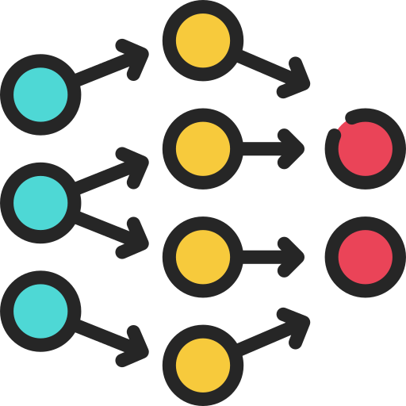


1.1 Opportunistic Learning
Identifying diseases incidentally during tests conducted for other reasons.
Deep
Neural Network
Unexpected
Diseases
Health Checkup
ECG
X-ray
Retinal Fundus
Uses existing data
No need for additional procedures (low cost and efficient)
Enables early detection and efficient diagnosis

Slide 6
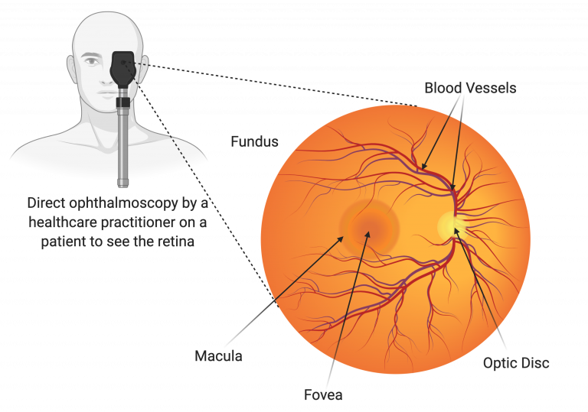
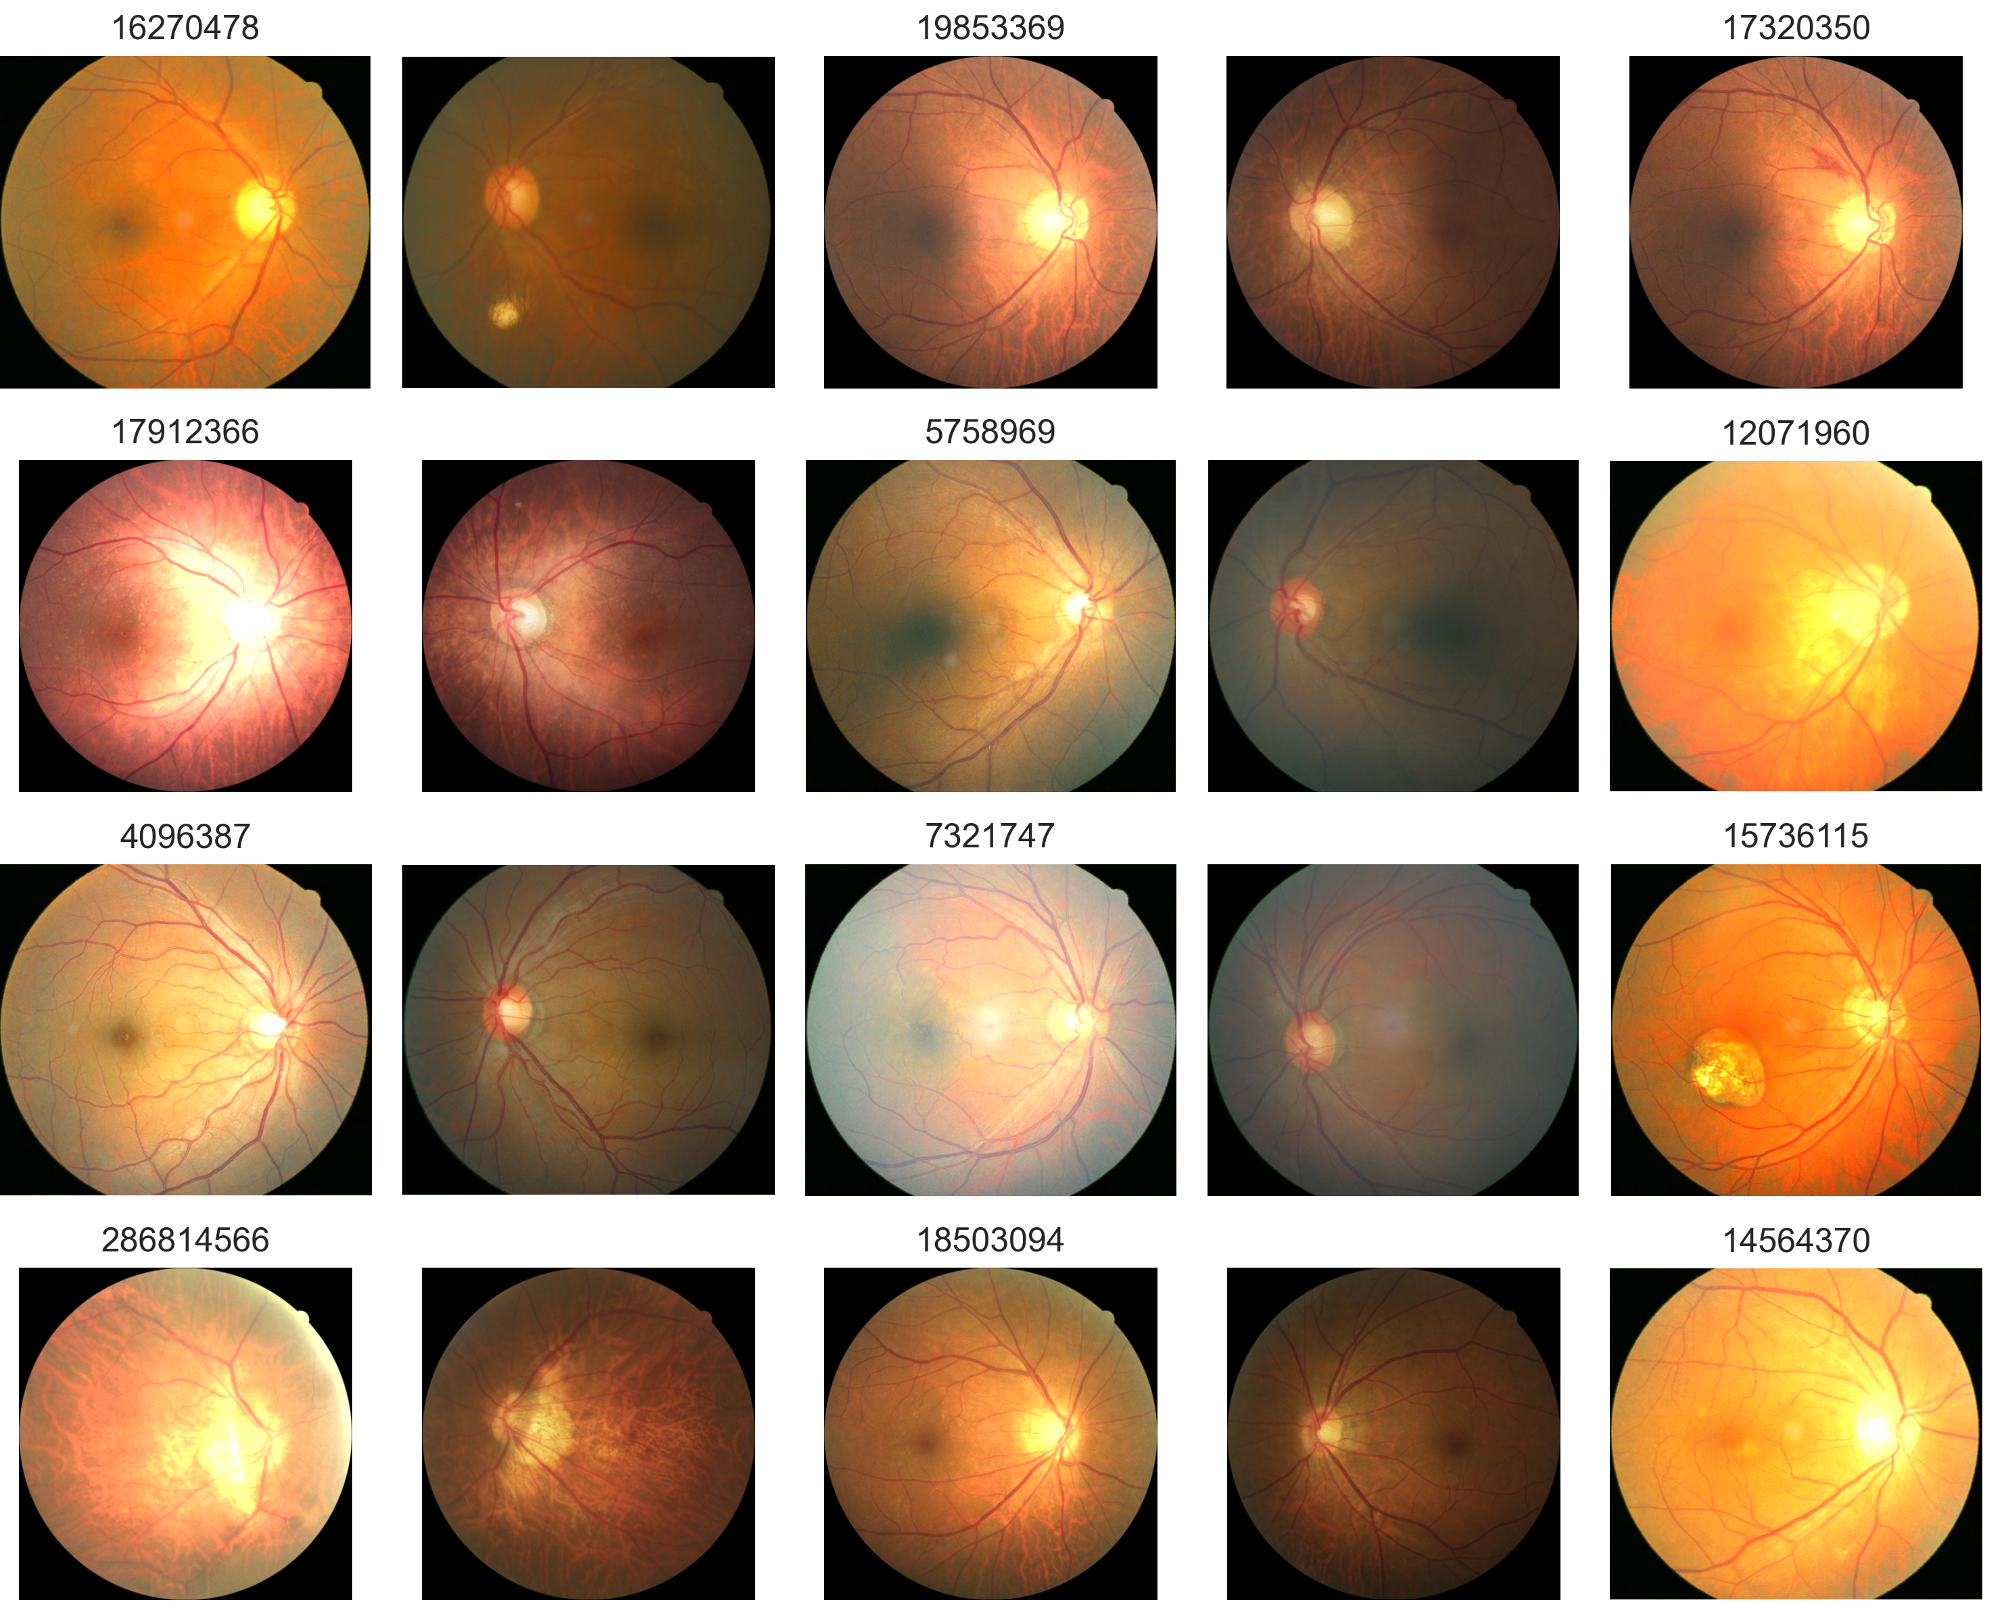
1.2 Retinal Images and Deep Learning
Diabetic Retinopathy
Age-related Macular Degeneration (AMD)
Glaucoma
Retinal Detachment
Cardiovascular Disease
Hypertension
Atherosclerosis
Alzheimer’s Disease
Parkinson’s Disease
Notes:
Diabetic Retinopathy (당뇨망막병증)
Age-related Macular Degeneration (AMD) (노인성 황반변성)
Glaucoma (녹내장) – 시신경유두 컵-디스크 비율로 판단
Retinal Detachment (망막박리)

Slide 7
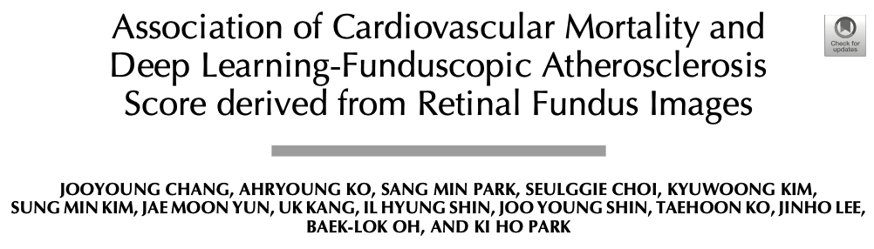
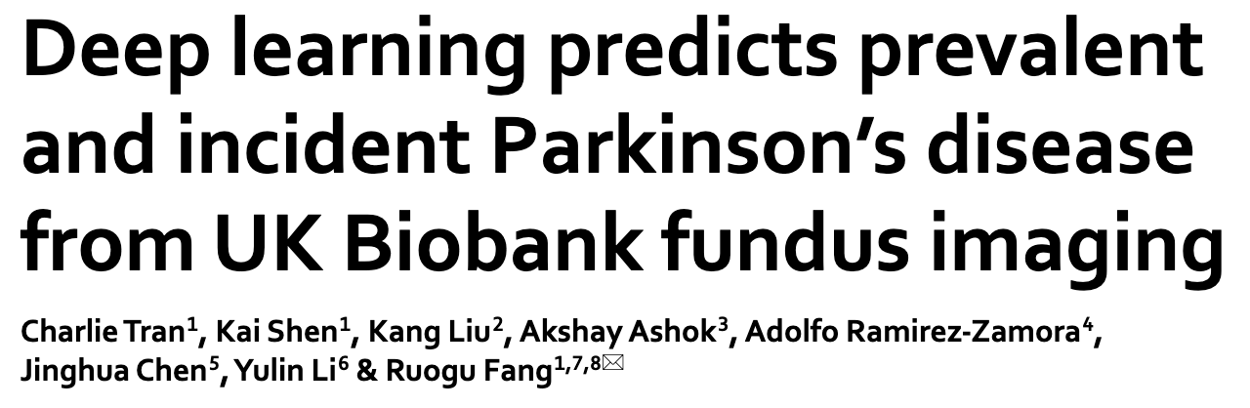
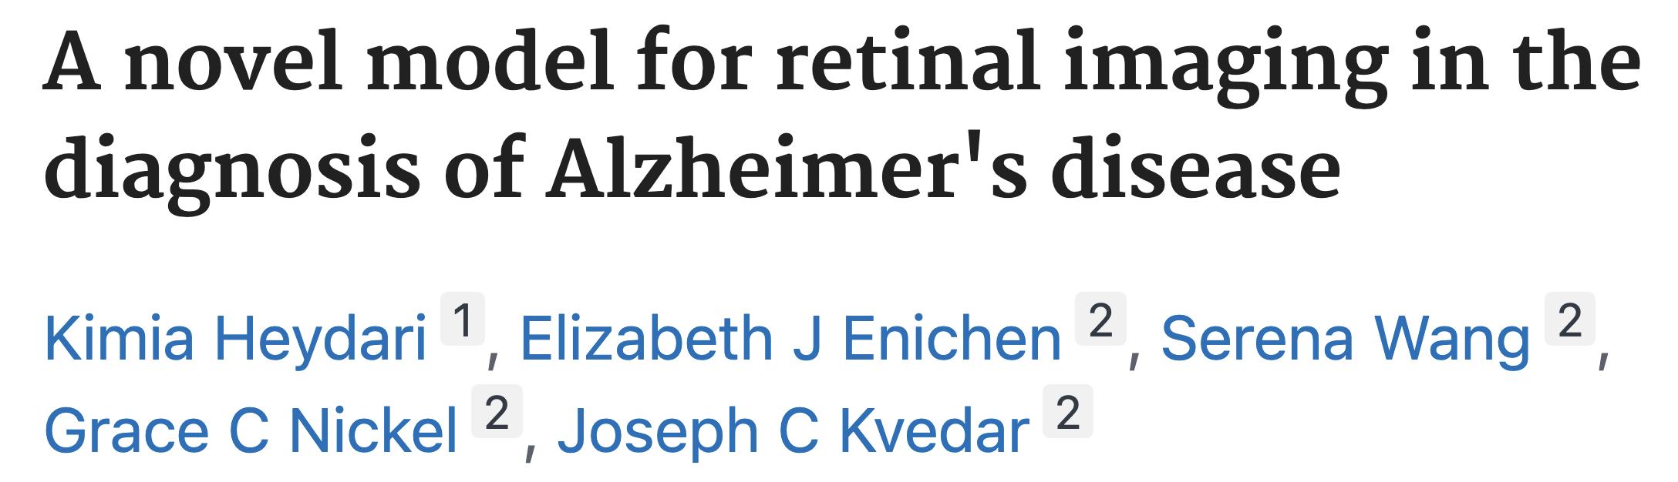
1.2 Retinal Images and Deep Learning
Diabetic Retinopathy
Age-related Macular Degeneration (AMD)
Glaucoma
Retinal Detachment
Opportunistic Learning with Retinal Images
Cardiovascular Disease
Hypertension
Atherosclerosis
Alzheimer’s Disease
Parkinson’s Disease
Notes:
Diabetic Retinopathy (당뇨망막병증)
Age-related Macular Degeneration (AMD) (노인성 황반변성)
Glaucoma (녹내장) – 시신경유두 컵-디스크 비율로 판단
Retinal Detachment (망막박리)

Slide 8
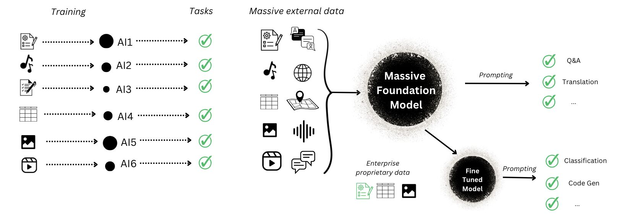
1.3 Foundation Models and Fine-tuning Methods
https://humanloop.com/blog/foundation-models

Slide 9
1.3 Foundation Models and Fine-tuning Methods
Traditional ML / DL models are Task Specific models that works well only specific task or dataset
https://humanloop.com/blog/foundation-models

Slide 10
1.3 Foundation Models and Fine-tuning Methods
Foundation models are large-scale models trained on massive datasets and are capable of performing well across a wide range of general tasks.
https://humanloop.com/blog/foundation-models

Slide 11
1.3 Foundation Models and Fine-tuning Methods
Since foundation models are large, they require efficient fine-tuning methods for downstream tasks.
https://humanloop.com/blog/foundation-models
Notes:
그래서 다양한 조합의 모델들을 개발 할 수 있다.

Slide 12



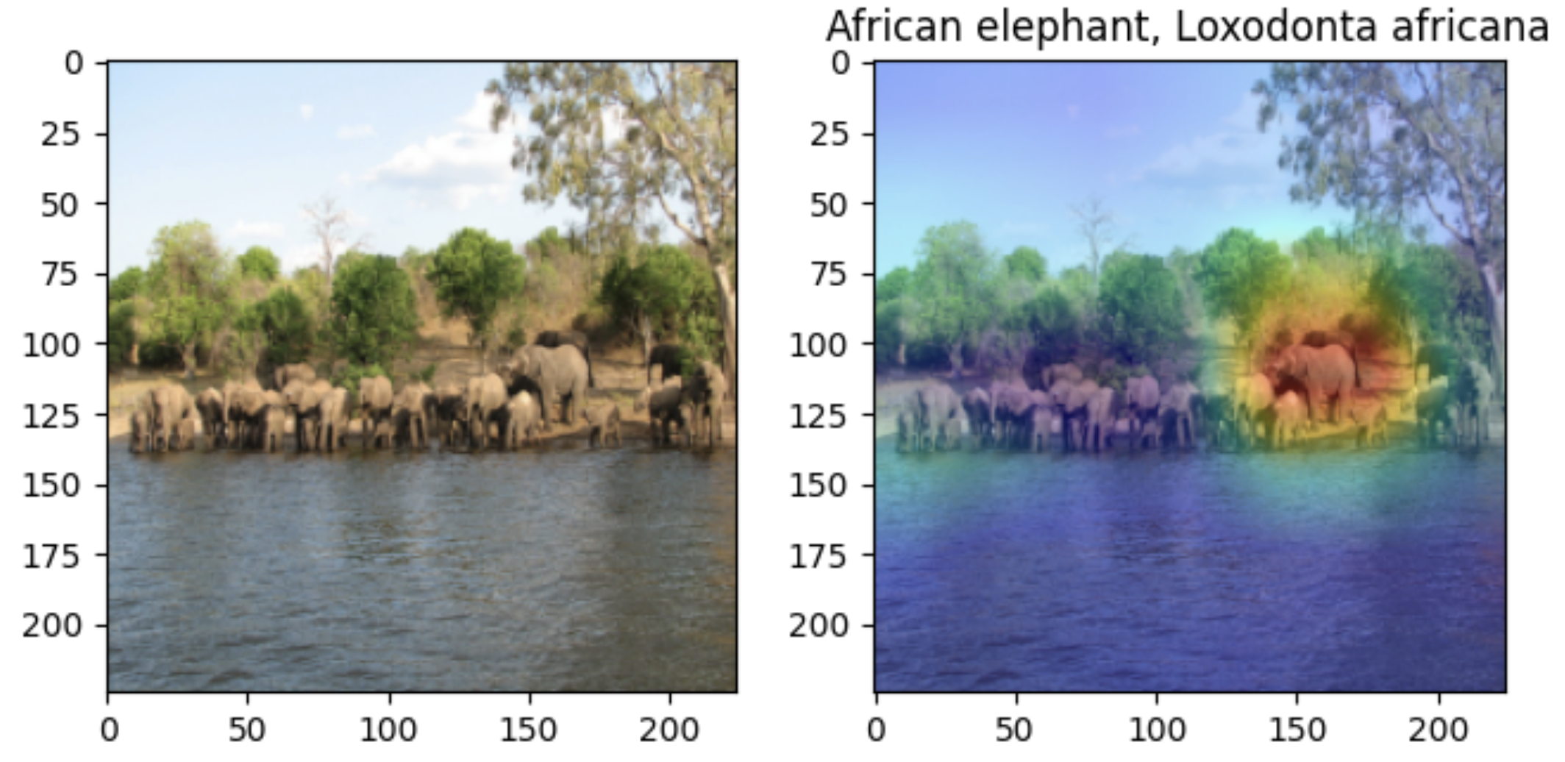
1.4 Explainability
Deep Learning model is Black Box Model
Doctors should explain the AI Decision to patients
GradCAM shows which parts of the image the model used for decision.
https://github.com/hyeok-jong/gradcam

Slide 13


1.5 Purpose of this Research
In this study
Developing an atherosclerosis prediction model using retinal images with various foundation models and fine-tuning methods.
To quantify and compare explainability, the “average saliency intensity” metric was proposed, measuring alignment between saliency maps and vessel regions.

Slide 14
2. Method
2.1 Study Design and Dataset
2.2 Foundation Models
2.3 Fine-tuning Methods
2.4 Explainability

Slide 15
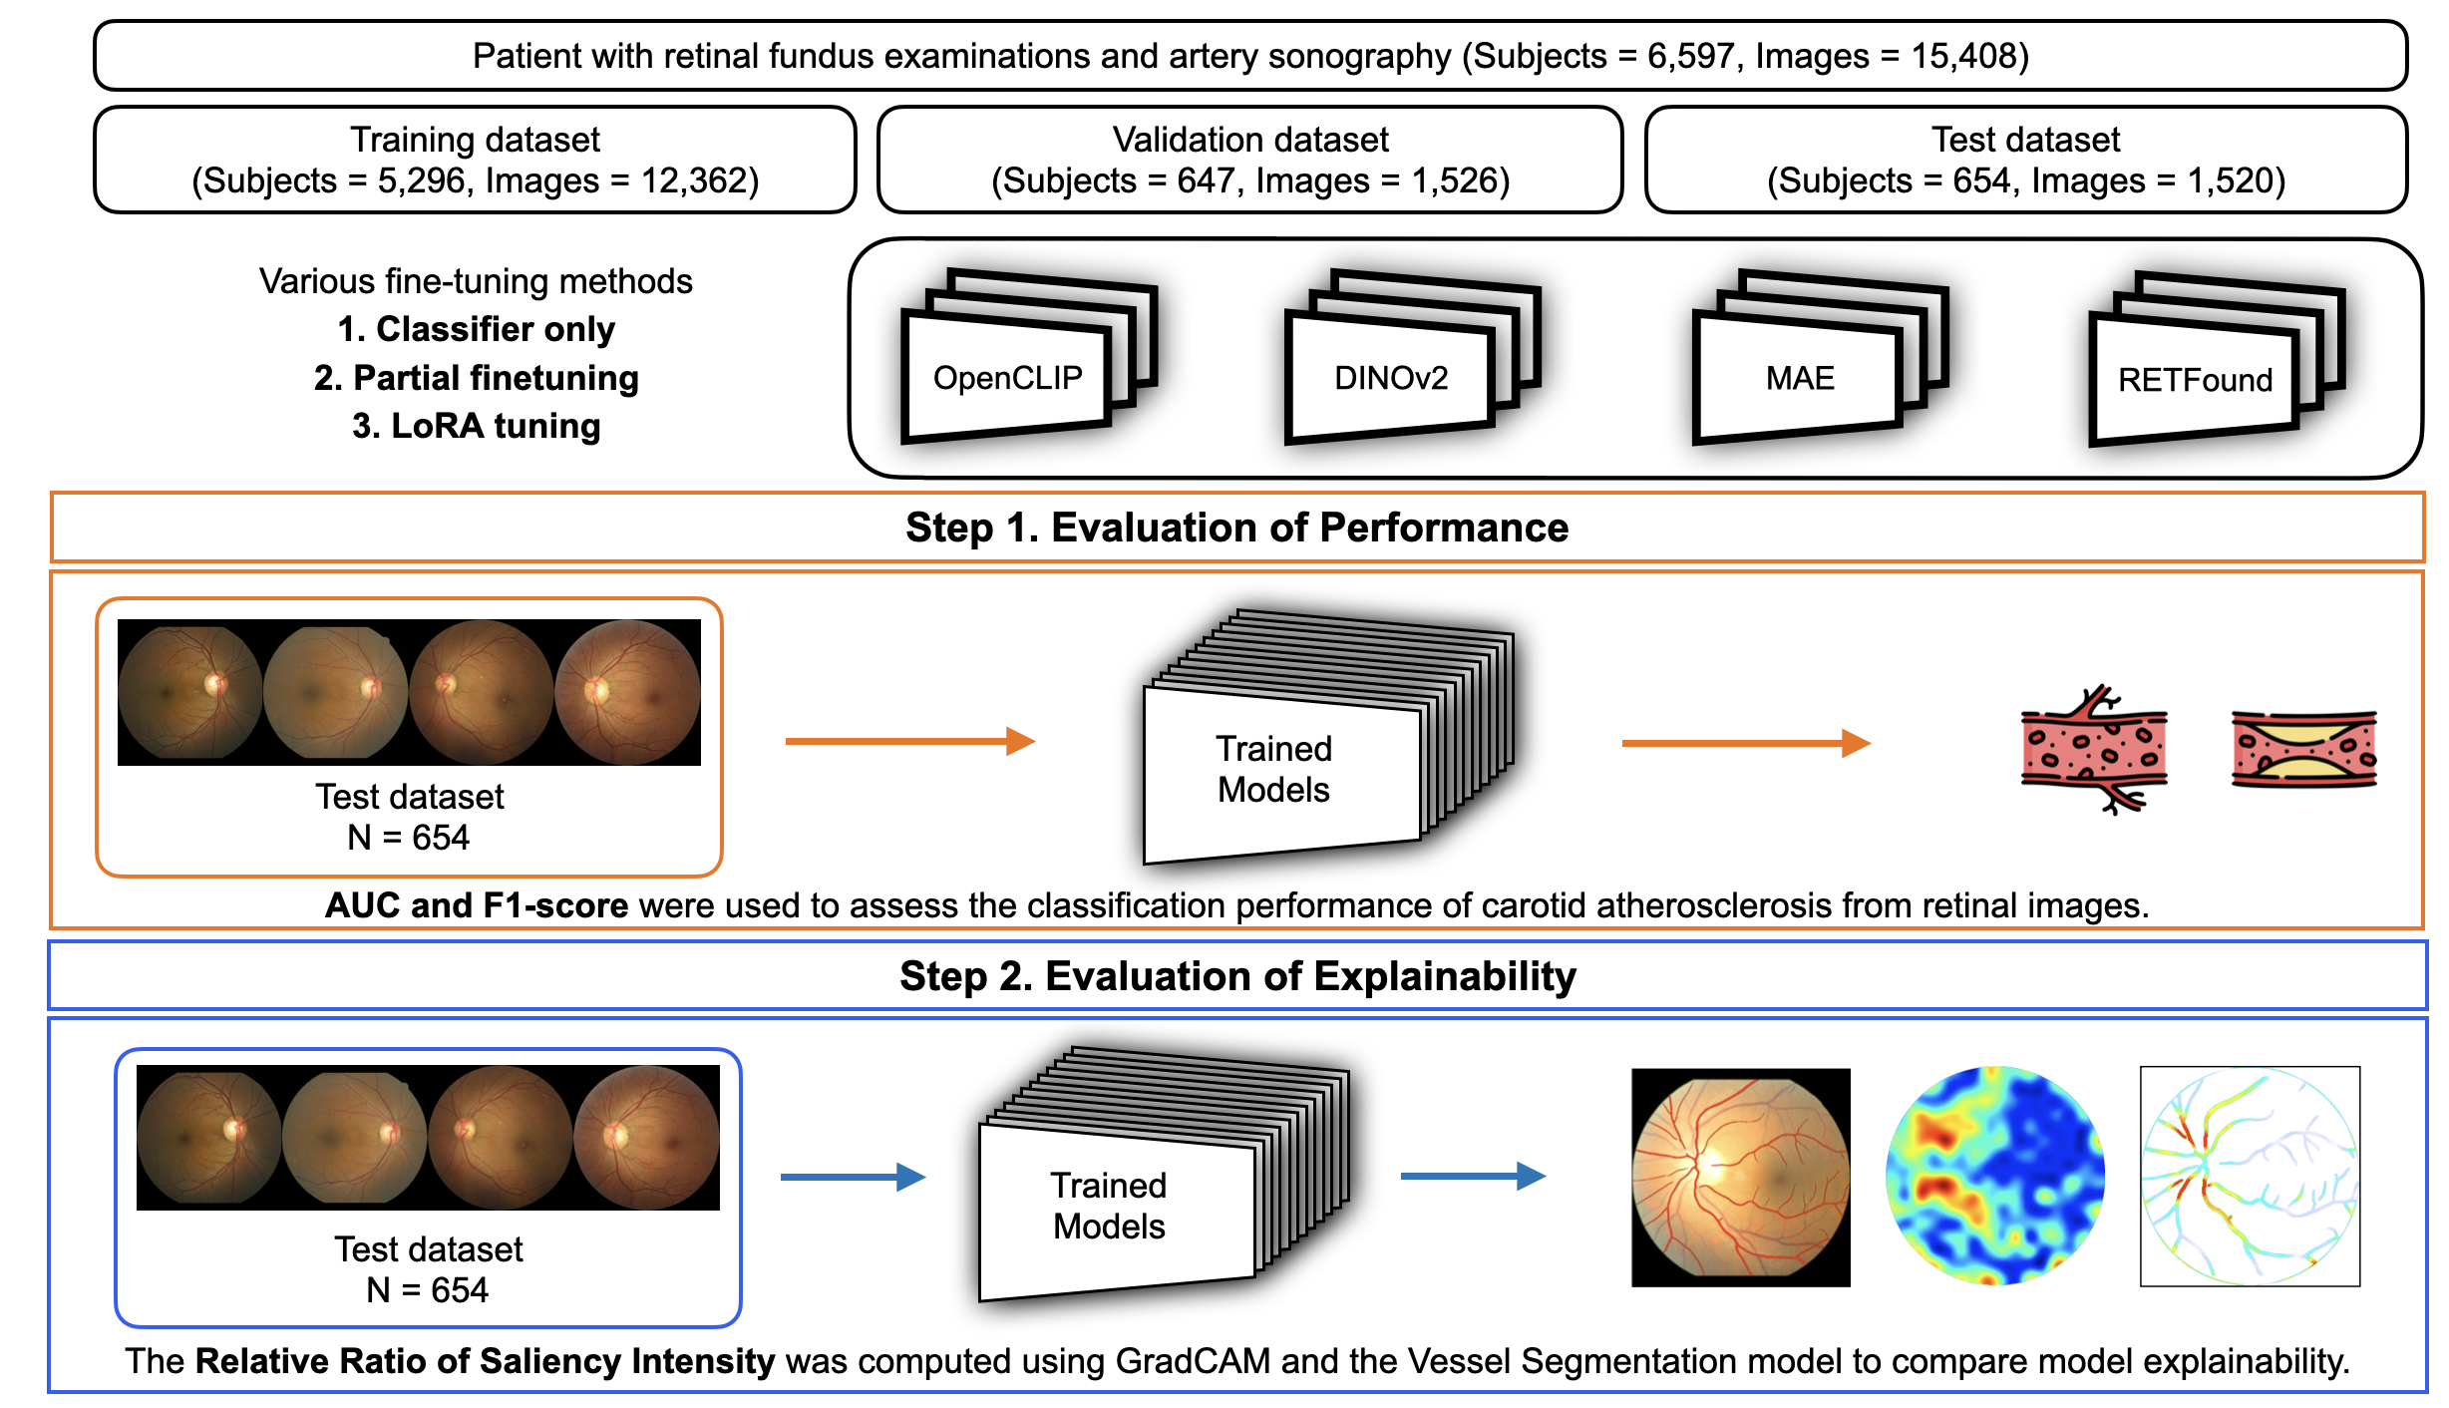
2.1 Study Design and Dataset
Health check-up data were collected from the Health Promotion Center of Seoul National University Hospital (HPC-SNUH).
A total of 6,597 individuals who underwent both retinal fundus photography and carotid ultrasound between January 2005 and December 2016 were included.
15,408 retinal fundus images were used for analysis.
IRB No. H-1703-044-837

Slide 16
2.2 Foundation Models
Model | Pretraining Data | SSL Strategy | Architecture | Strength
(Open) CLIP | LAION‑400M (400 M image‑text) LAION‑2B English subset (2 B pairs) | Contrastive Learning | ViT Giant | A general-purpose vision encoder with strong multimodal understanding across vision-language tasks.
DINOv2 | LVD‑142M (≈142 M curated images) | Self Distillation | ViT Giant | Excels in transfer learning by providing robust global and patch-level visual representations.
RETFound | ~1.6 M unlabelled retinal fundus + OCT images | Masked Auto Encoder (MAE) | ViT Large | Tailored for retinal images, demonstrating strong performance in both classification and prognosis.

Slide 17
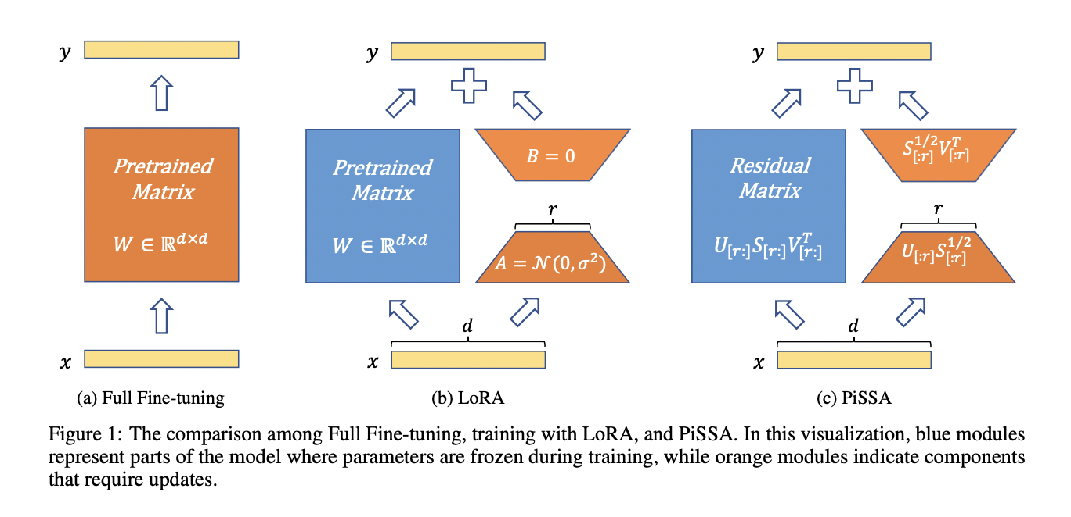
2.3 Finetuning Methods
Freeze ❄️
Trainable 🔥
Full-finetuning
Classifier only
Partial finetuning
LoRA Tuning

Slide 18
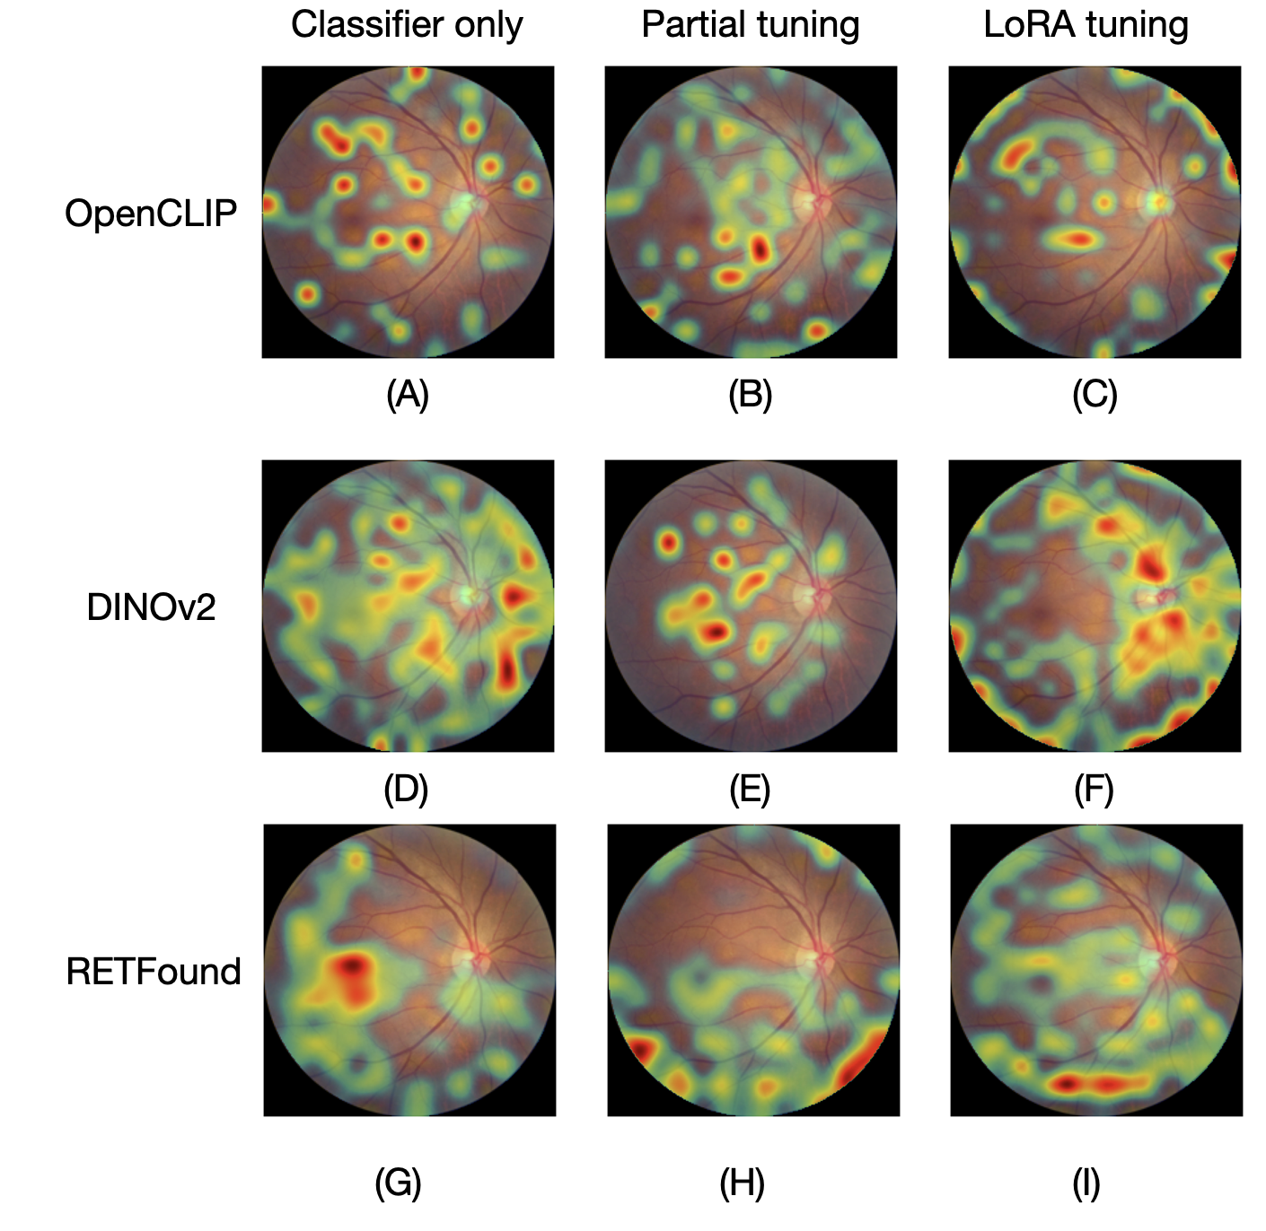
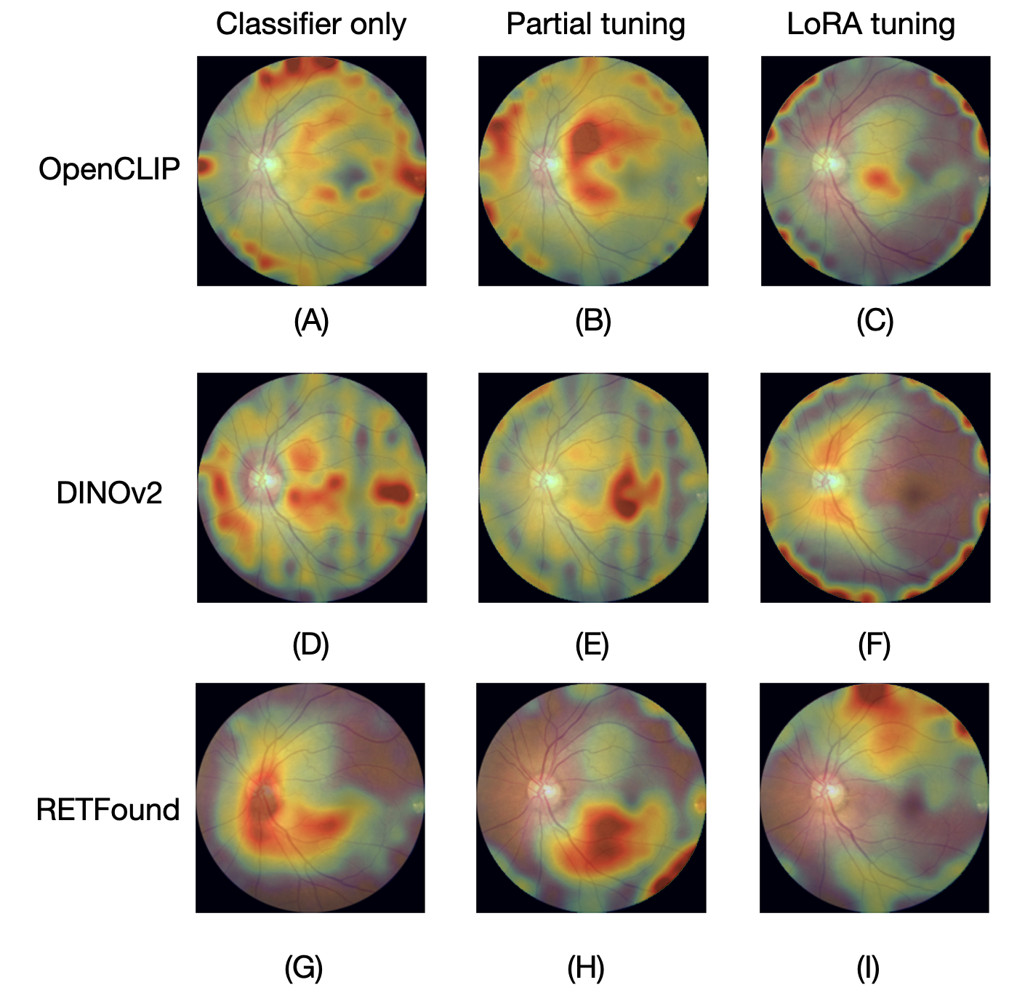
2.4 Explainability
High
Low
GradCAM for a single image
Averaged Grad-CAM across multiple images

Slide 19
2.4 Explainability
High
Low
Problems of Saliency Map
Prone to cherry-picking bias.
Qualitative and subjective
GradCAM for a single image
Averaged Grad-CAM across multiple images

Slide 20
2.4 Explainability
High
Low
Problems of Saliency Map
Prone to cherry-picking bias.
Qualitative and subjective
GradCAM for a single image
Averaged Grad-CAM across multiple images

Slide 21
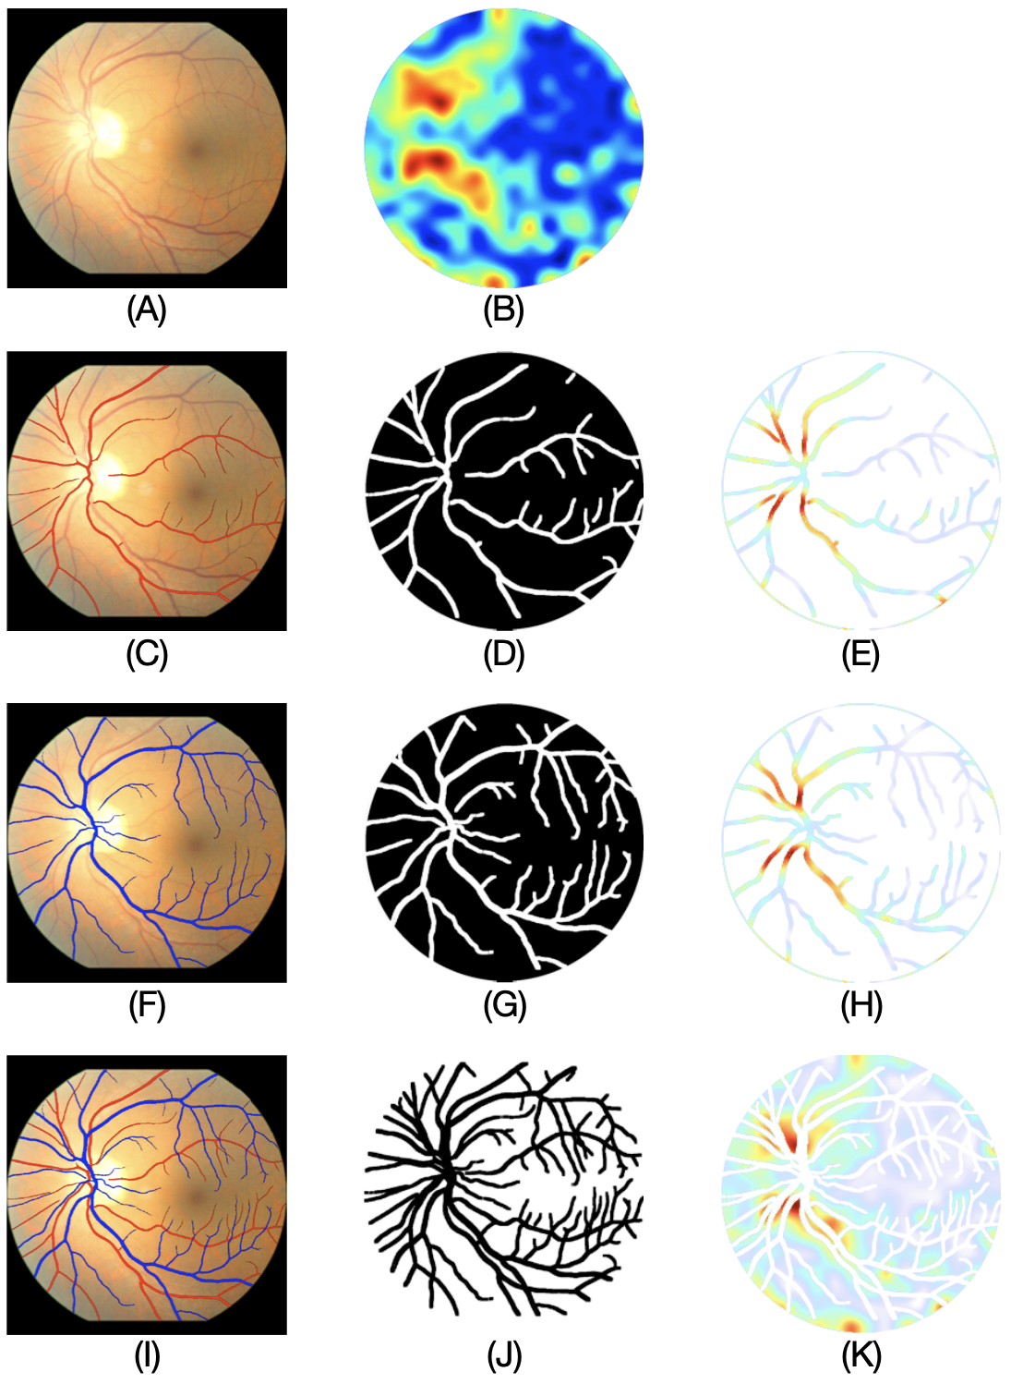
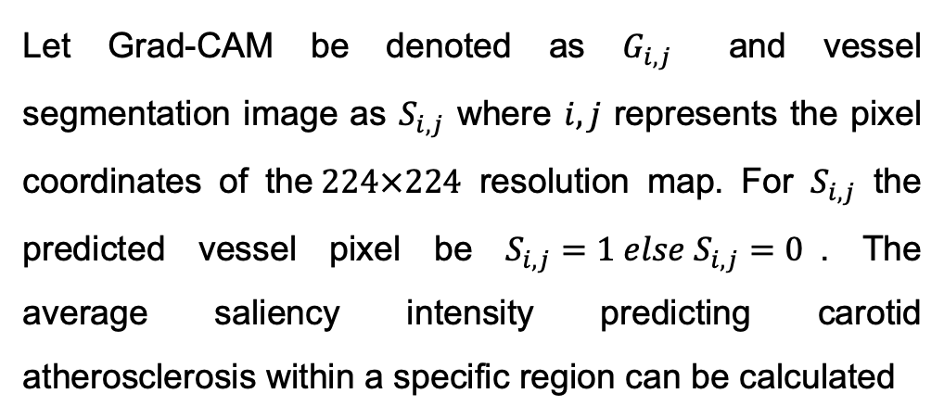
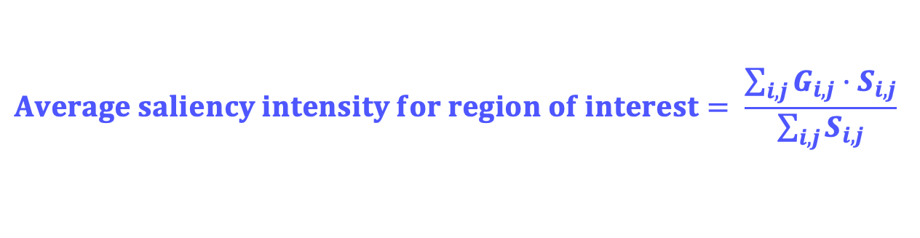
2.4 Explainability
High
Low
$$\begin{aligned}Average saliency intensity for region of interest= \frac{\sum_{i,j}{G_{i,j}·S_{i,j}}}{\sum_{i,j}{S_{i,j}}} \#\end{aligned}$$
Let Grad-CAM be denoted as $G_{i,j}$ and vessel segmentation image as $S_{i,j}$ where $i,j$ represents the pixel coordinates of the$224×224$ resolution map. For $S_{i,j}$ the predicted vessel pixel be $S_{i,j}=1 else S_{i,j}=0$. The average saliency intensity predicting carotid atherosclerosis within a specific region can be calculated

Slide 22
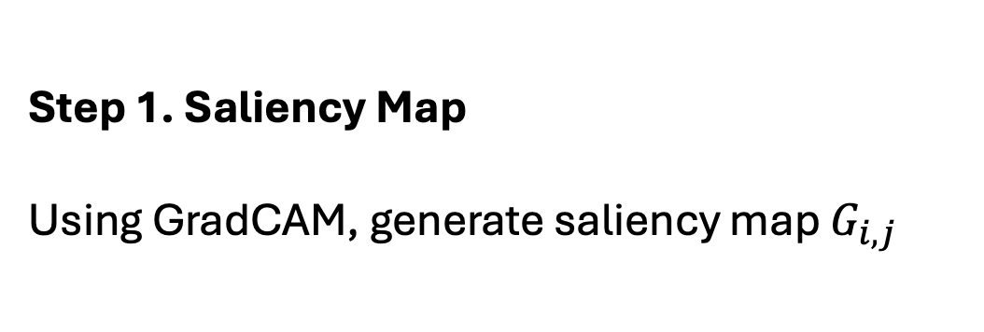
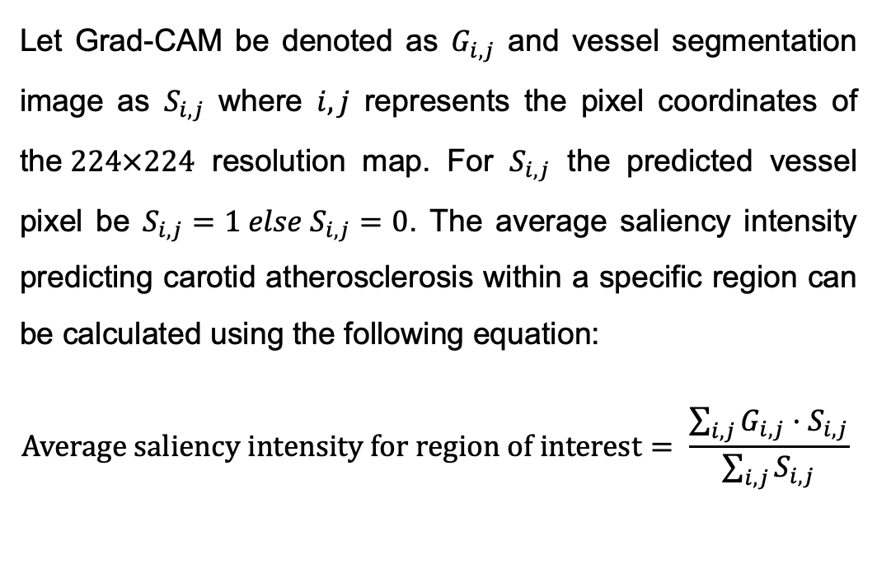
2.4 Explainability
High
Low
Let Grad-CAM be denoted as $G_{i,j}$ and vessel segmentation image as $S_{i,j}$ where $i,j$ represents the pixel coordinates of the$224×224$ resolution map. For $S_{i,j}$ the predicted vessel pixel be $S_{i,j}=1 else S_{i,j}=0$. The average saliency intensity predicting carotid atherosclerosis within a specific region can be calculated using the following equation:
$$\begin{aligned}Average saliency intensity for region of interest= \frac{\sum_{i,j}{G_{i,j}·S_{i,j}}}{\sum_{i,j}{S_{i,j}}} \#\end{aligned}$$
Step 1. Saliency Map
Using GradCAM, generate saliency map $G_{i,j}$
(A)= Original Image
(B) = GradCAM Saliency Map

Slide 23
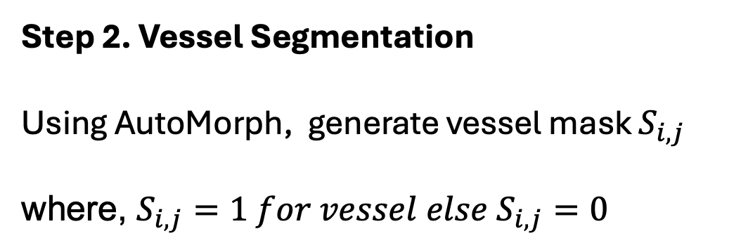
2.4 Explainability
High
Low
Let Grad-CAM be denoted as $G_{i,j}$ and vessel segmentation image as $S_{i,j}$ where $i,j$ represents the pixel coordinates of the$224×224$ resolution map. For $S_{i,j}$ the predicted vessel pixel be $S_{i,j}=1 else S_{i,j}=0$. The average saliency intensity predicting carotid atherosclerosis within a specific region can be calculated using the following equation:
$$\begin{aligned}Average saliency intensity for region of interest= \frac{\sum_{i,j}{G_{i,j}·S_{i,j}}}{\sum_{i,j}{S_{i,j}}} \#\end{aligned}$$
Step 2. Vessel Segmentation
Using AutoMorph, generate vessel mask $S_{i,j}$
where, $S_{i,j}=1 for vessel else S_{i,j}=0$
(C, D) = Artery
(F, G) = Vein
(J) = (A) \ (C∪F) = Non-Vessel regions

Slide 24
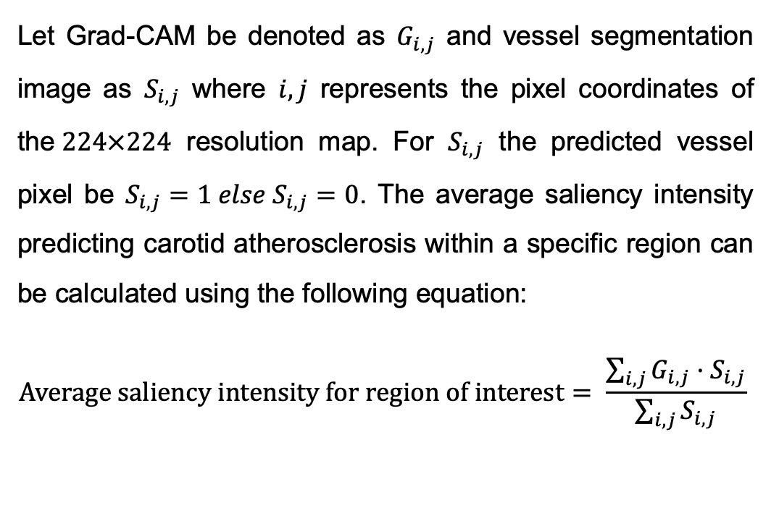
2.4 Explainability
High
Low
Let Grad-CAM be denoted as $G_{i,j}$ and vessel segmentation image as $S_{i,j}$ where $i,j$ represents the pixel coordinates of the$224×224$ resolution map. For $S_{i,j}$ the predicted vessel pixel be $S_{i,j}=1 else S_{i,j}=0$. The average saliency intensity predicting carotid atherosclerosis within a specific region can be calculated using the following equation:
$$\begin{aligned}Average saliency intensity for region of interest= \frac{\sum_{i,j}{G_{i,j}·S_{i,j}}}{\sum_{i,j}{S_{i,j}}} \#\end{aligned}$$
Step 3. Average Saliency Intensity
(B) ⊙ (D) => (E) : GradCAM for only artery
Sum(E) / Sum(D) : Average saliency intensity for artery
Repeat for [Vein, Vein + Artery, Non - Vessel]
Relative Ration : [Artery, Vein, Vein + Artery] / [Non-Vessel]
⊙ : Hadamard product (pixel-wise multiplication)

Slide 25
3. Results and Discussion
3.1 Performance Comparison
3.2 Explainability Comparison
3.3 Correlation between performance and explainability

Slide 26
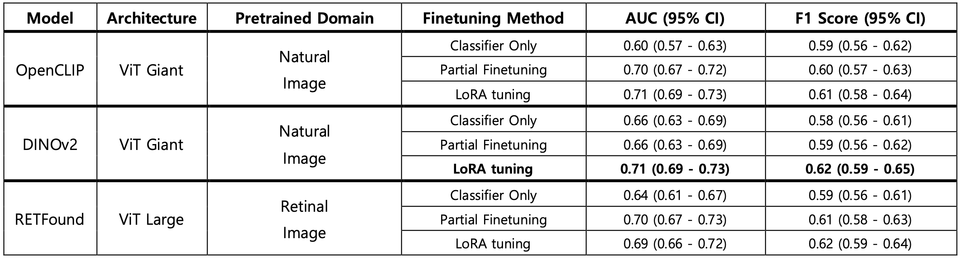
3.1 Performance Comparison
Discussion Point 1:
LoRA consistently improves performance across various foundation models
Discussion Point 2:
RETFound, despite being pretrained on retinal images, does not always yield optimal performance

Slide 27
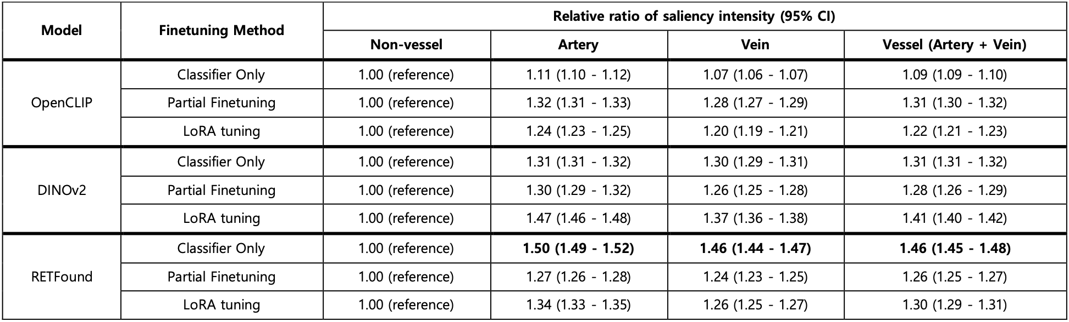
3.2 Explainability Comparison
The relative ratio of saliency intensity quantifies how much more the Grad-CAM focuses on vessel regions compared to non-vessel regions.
Discussion Point 3:
Although RETFound with classifier-only fine-tuning showed suboptimal performance, it demonstrated the highest level of explainability.

Slide 28


3.3 Correlation between performance and explainability
Discussion Point 4: The explainability ranking did not align with model performance.
Spearman’s rank Test
correlation coefficient
p = 0.343

Slide 29

Conclusion
In this study
Among all models, DINOv2 with LoRA tuning achieved the best classification performance for atherosclerosis prediction using retinal fundus images.
A new explainability metric, average saliency intensity for regions of interest, was proposed to quantitatively assess how much Grad-CAM focuses on clinically relevant vessel regions.
Model performance and explainability did not always align.
RETFound with classifier-only fine-tuning showed the highest explainability despite lower performance, emphasizing the need for multi-dimensional evaluation.

Slide 30
Thank you for listening
2025년도 1학기
[의료 데이터 기반 인공지능과 기계학습의 기초]
기말고사 프로젝트
서울대학교 의과학과
2023-24885 이설하
2023-24526 이혁종

Slide 31
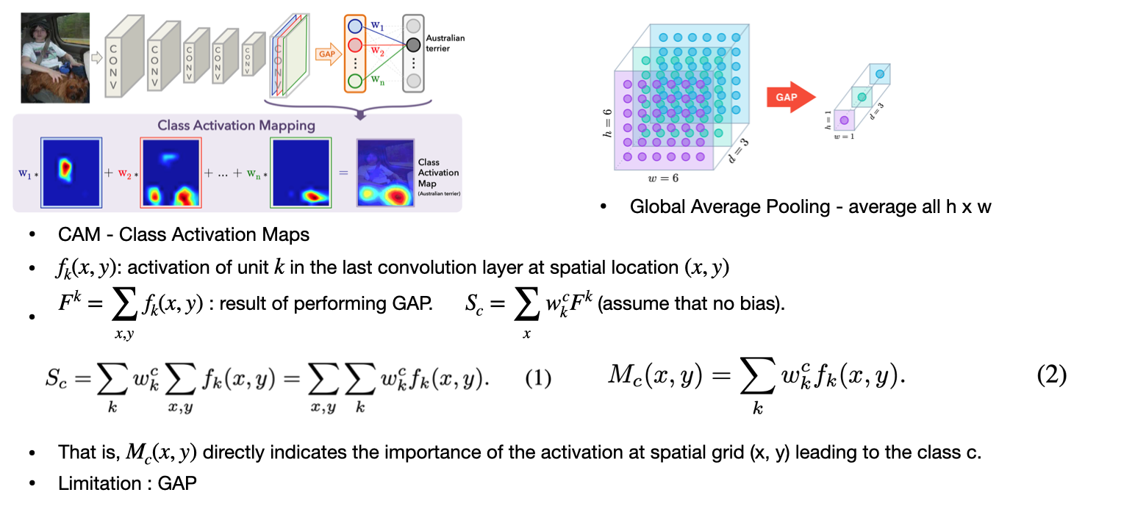
Appendix

Slide 32
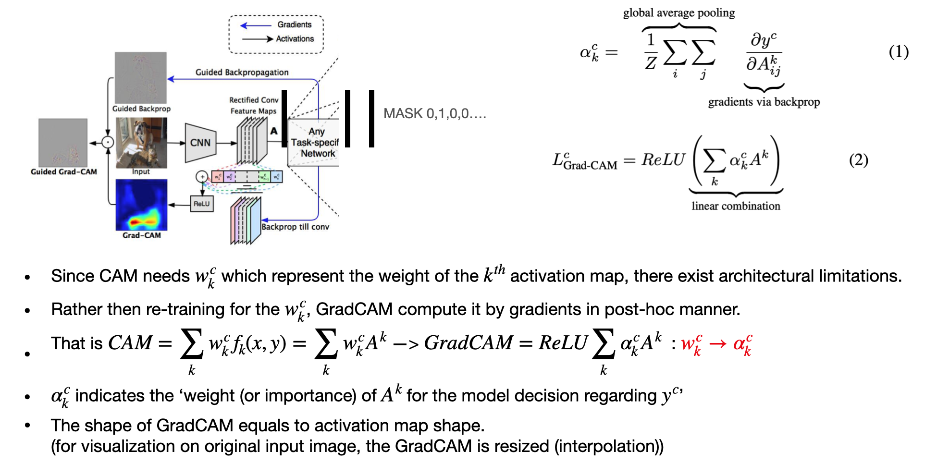
Appendix

